Slide 1
Chapter 3 Intensity Transformation and Spatial Filtering
Part1: Intensity Transformation

Slide 2
3.1 Background
3.1.1 Intensity Transform
g[x,y]=T[f[x,y]], T is a unary function
3.1.2 Spatial Filtering

Slide 3
3.1.2 Spatial Filtering
0 | -1 | 0
-1 | 5 | -1
0 | -1 | 0
*
 | 5 | 5 | 4
 | 4 | 7 | 4
 | 4 | 4 | 3
 |  |  |  |  |  | #
*0 | *-1 | *0
*-1 | *5 | *-1
*0 | *-1 | *0

Slide 4
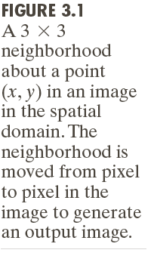
3.1.2 Spatial Filtering

Slide 5
Image Enhancement
Enhancement is the process of manipulating an image so that the result is more suitable than the original for specific application.

Slide 6
3.2 Some Basic Intensity Transform Functions

Slide 7
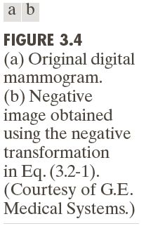
3.2 Some Basic Intensity Transform Functions
3.2.1 Image Negative
s = L-1-r

Slide 8
3.2.2 Log Transformations
s = c log(1+r), r >=0

Slide 9
3.2.2 Power (Gamma) Transformations

Slide 10
3.2.2 Power (Gamma) Transformations
[Programming]
How to accelerate?

Slide 11
3.2.2 Power (Gamma) Transformations

Slide 12
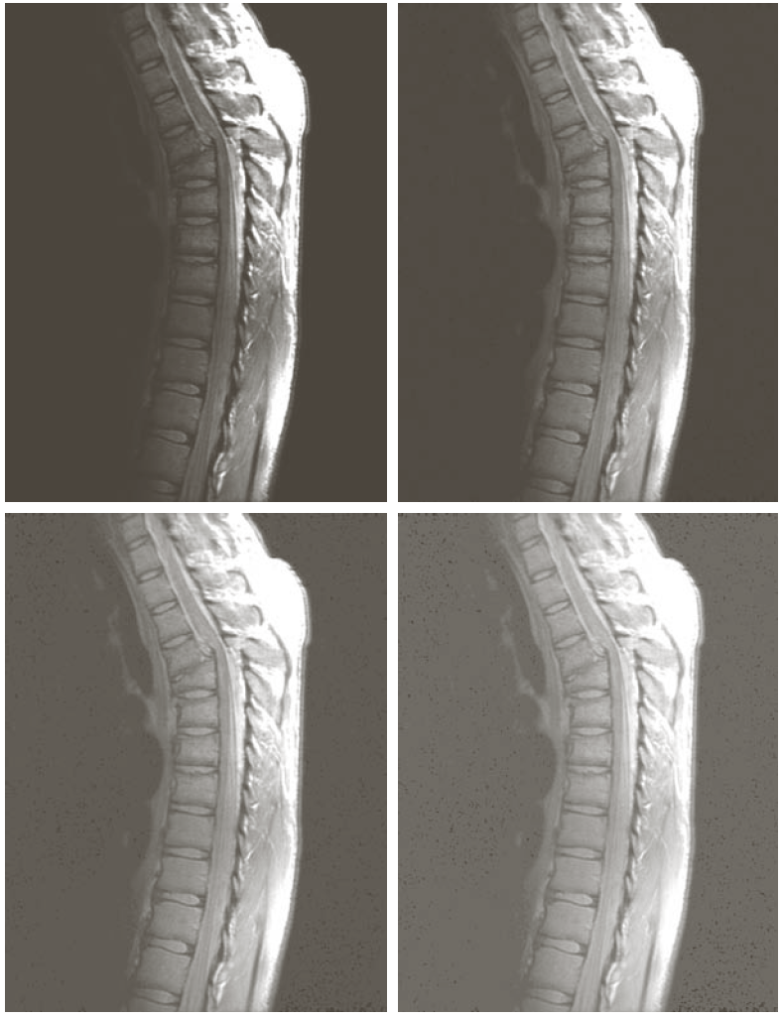
3.2.2 Power (Gamma) Transformations

Slide 13
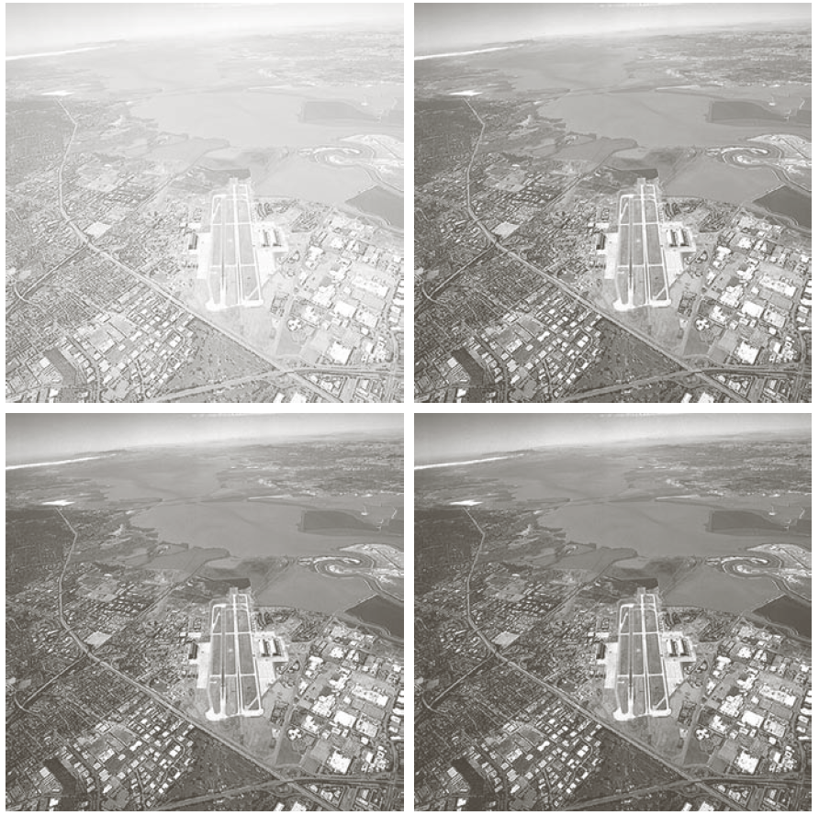
3.2.3 Power (Gamma) Transformations

Slide 14
3.2.4 Piecewise-Linear Transformation Functions I -Contrast stretching

Slide 15
Thresholding

Slide 16
3.2.4 Piecewise-Linear Transformation Functions II: Intensity-level slicing

Slide 17
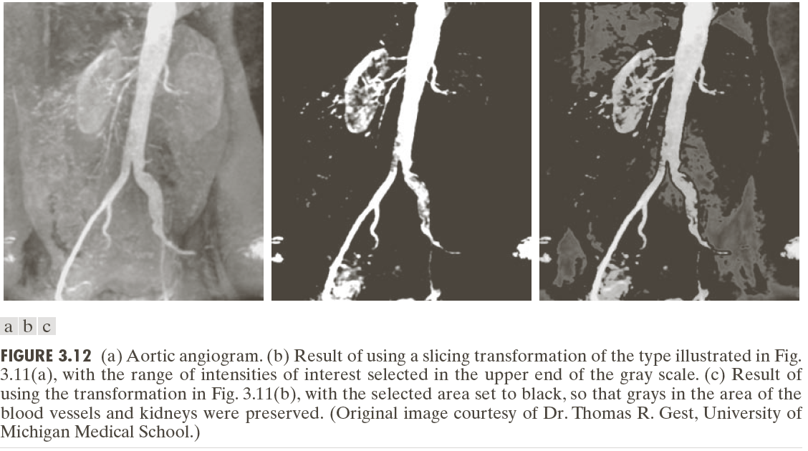
3.2.4 Piecewise-Linear Transformation Functions II: Intensity-level slicing

Slide 18
3.2.4 Piecewise-Linear Transformation Functions III: Bit-plane slicing

Slide 19
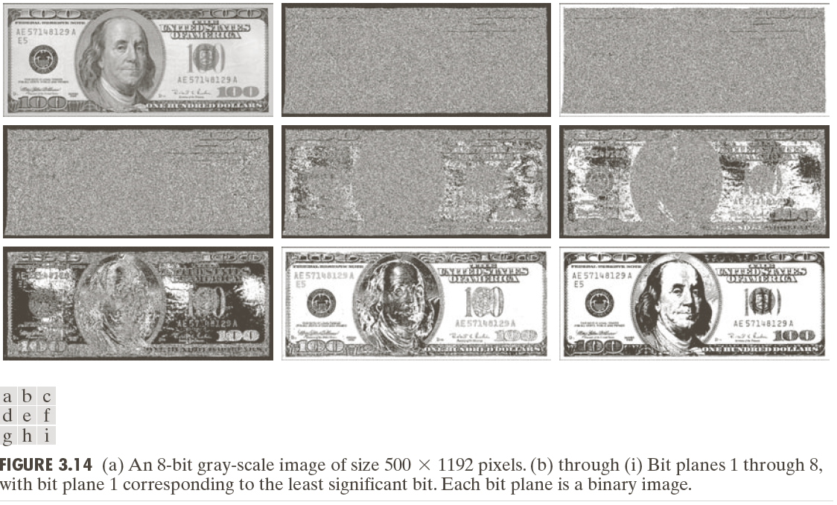
3.2.4 Piecewise-Linear Transformation Functions II: Bit-plane slicing

Slide 20
Bit-plane slicing
[Programming]

Slide 21
Bit-plane slicing
[Draw the bit-plane slicing function curve]

Slide 22
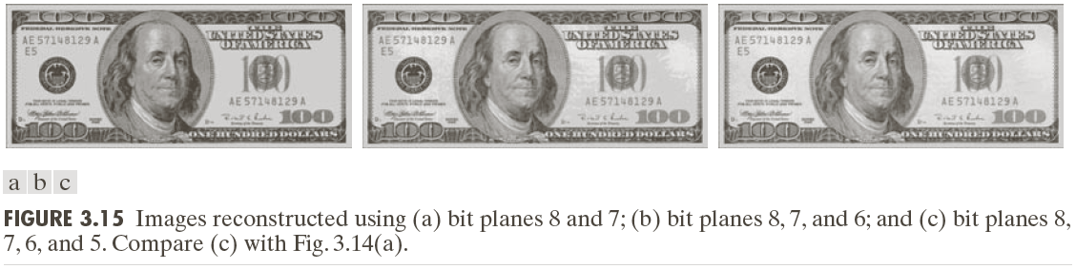
3.2.4 Piecewise-Linear Transformation Functions II: Bit-plane slicing

Slide 23
3.2.4 Brightness Transformation
Basic
g[x,y] = f[x,y]+c
g[x,y] = k f[x,y]
Saturation Operation
g[x,y] = S(f[x,y]+c)
g[x,y] = S(k f[x,y])
[Graph & Programming]

